Slide 1
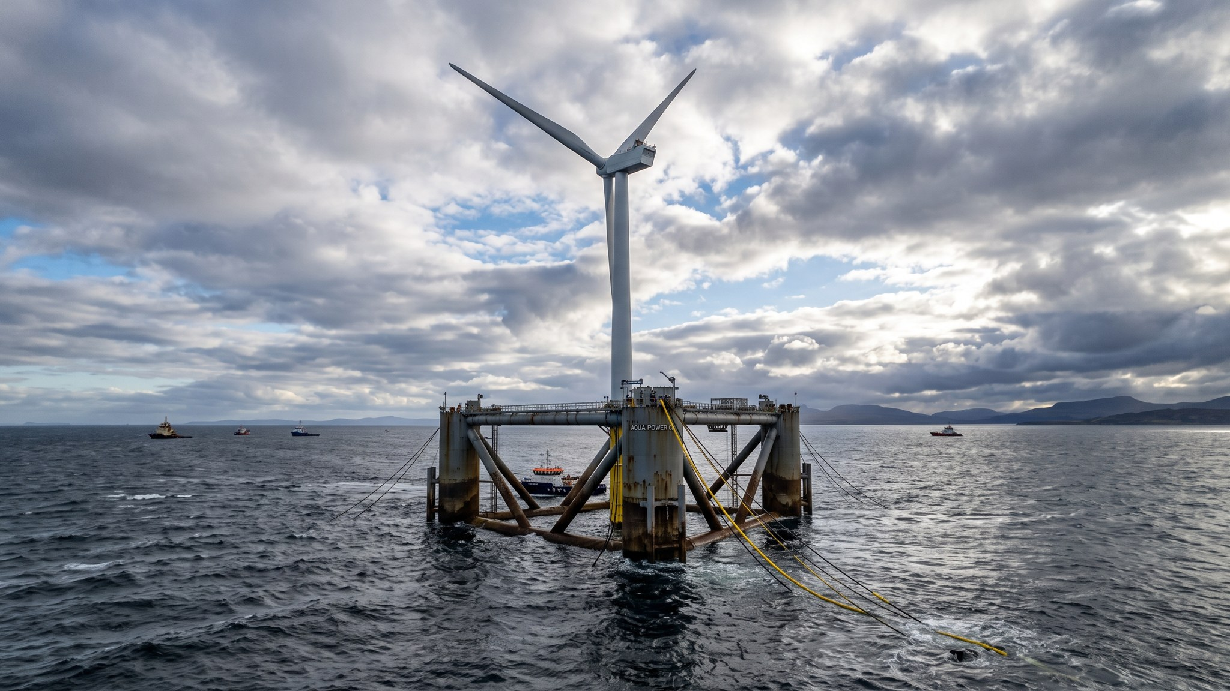
WEYLAND ENERGY
Technology Watch Q3 2026
Engineering & Site Surveys · leadership briefing

Slide 2
Five topics on our radar
• 15 MW+ offshore turbines – the next standard after the HTS-12
• Floating offshore wind – sites deeper than 60 m
• Grid-forming BESS inverters – new revenue at Fenwick
• Sodium-ion batteries – watch, not yet bankable
• PEM vs. alkaline electrolysers – input to the hydrogen pilot
WEYLAND ENERGY · Technology Watch Q3 2026
2

Slide 3
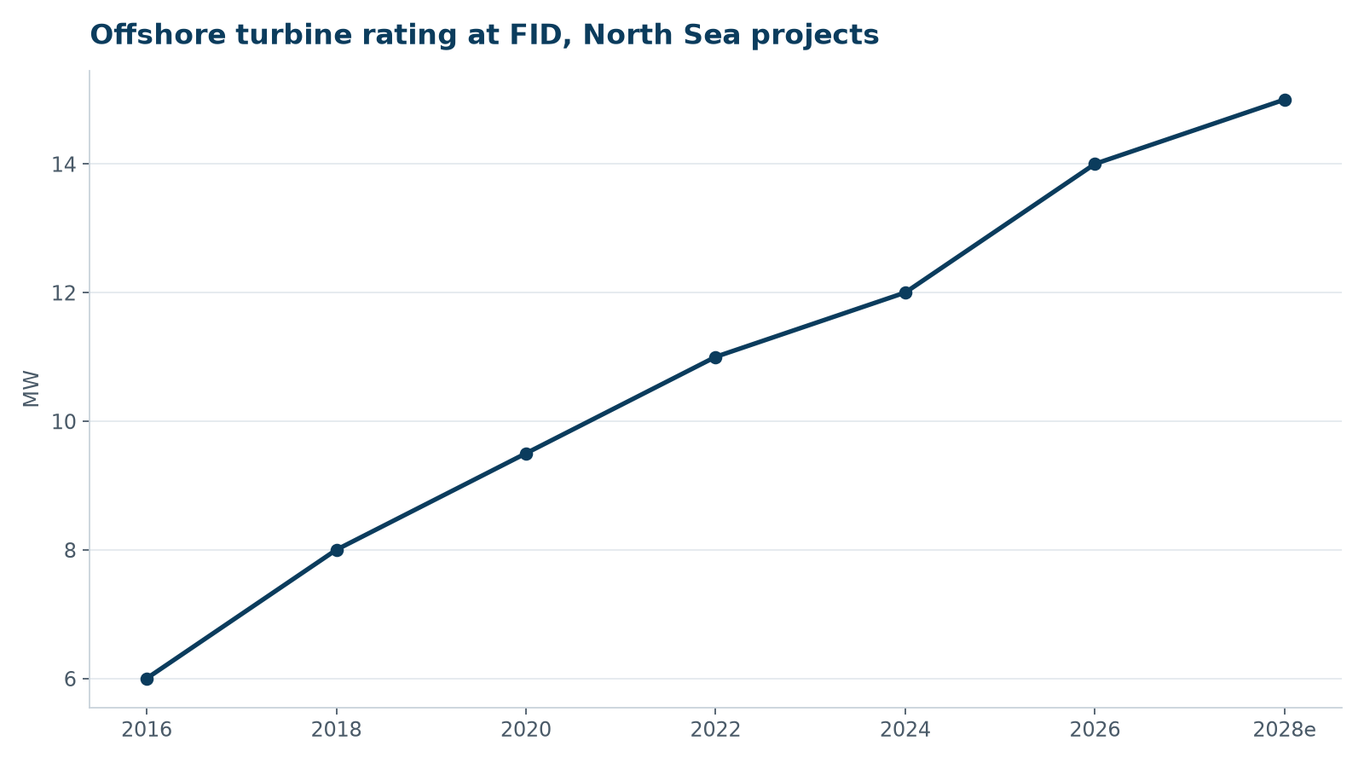
Turbines keep growing
• 15 MW at FID from 2028
• Fewer, bigger monopiles
• Vessel hook height becomes a constraint
WEYLAND ENERGY · Technology Watch Q3 2026
3

Slide 4
Floating offshore wind
Recommendation: learn as minority partner, do not lead before 2028

Slide 5
Readiness at a glance
Technology | Maturity | Relevance | Next step
15 MW turbines | Commercial | High | Northfield bid cost model
Floating wind | Pre-commercial | Medium | Partnership options
Grid-forming BESS | Early commercial | High | Fenwick RFP criterion
Sodium-ion | Early | Low | Revisit 2027
PEM electrolysers | Commercial | High | Vendor shortlist H2 pilot
WEYLAND ENERGY · Technology Watch Q3 2026
5

Slide 6
WEYLAND ENERGY
Discussion
Questions to Sofie Lindqvist

